Slide 1
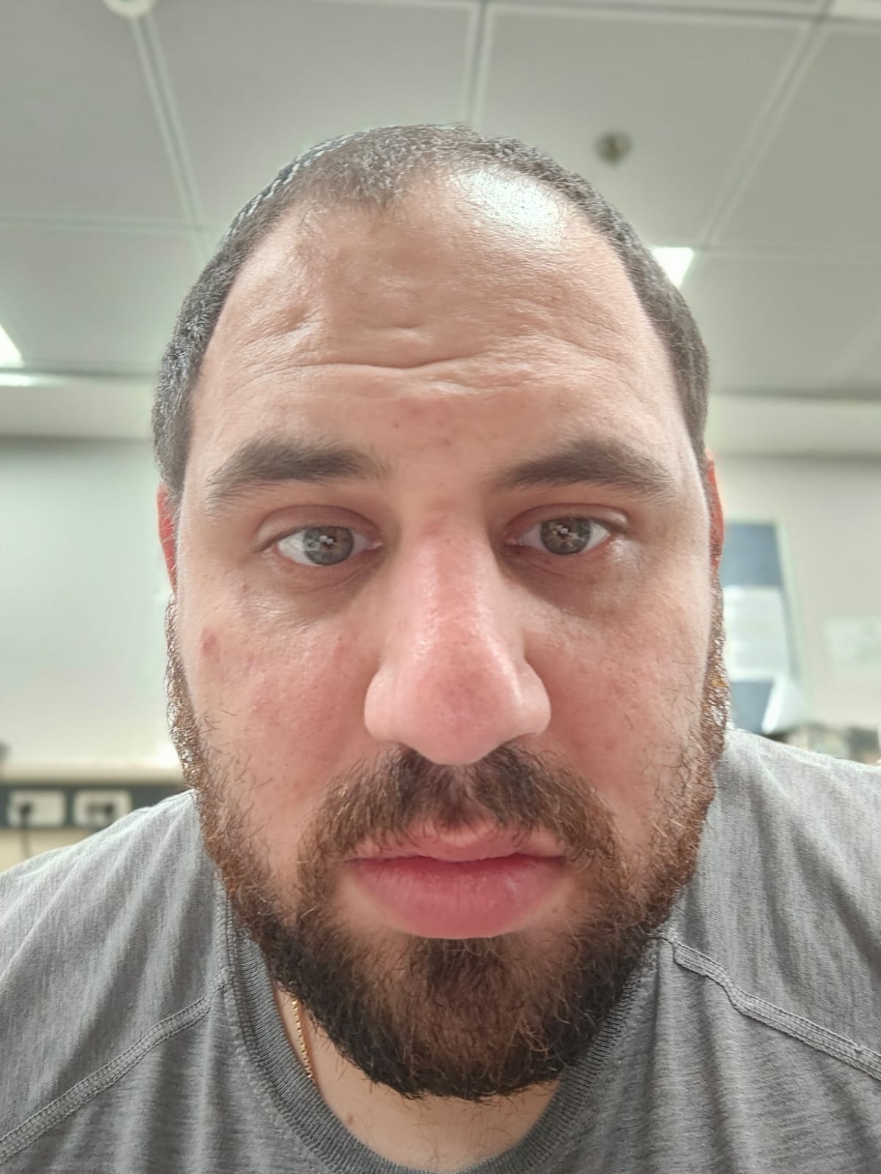

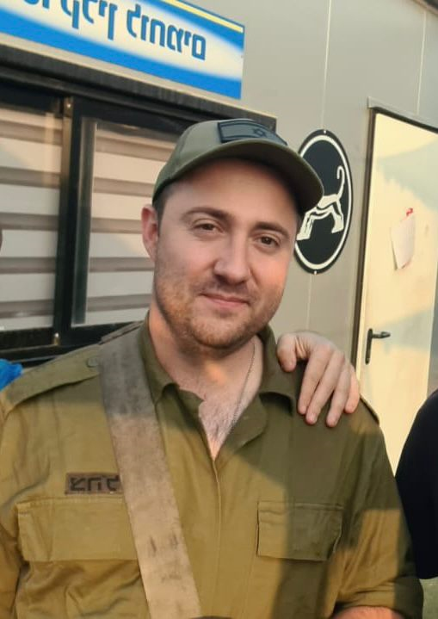
Course: Image Processing 31651 Assignment #13 Synthetic Image Creation (Part 3)
Photo of the student | Shorten Name | ID (4 last digits)
 | shienfeld | 1950 | Student #1
 | pony | 2210 | Student #2
 | akimov | 7939 | Student #3
Photo of the student | Shorten Name | ID (4 last digits)
 | shienfeld | 1950 | Student #1
 | pony | 2210 | Student #2
 | akimov | 7939 | Student #3

Slide 2
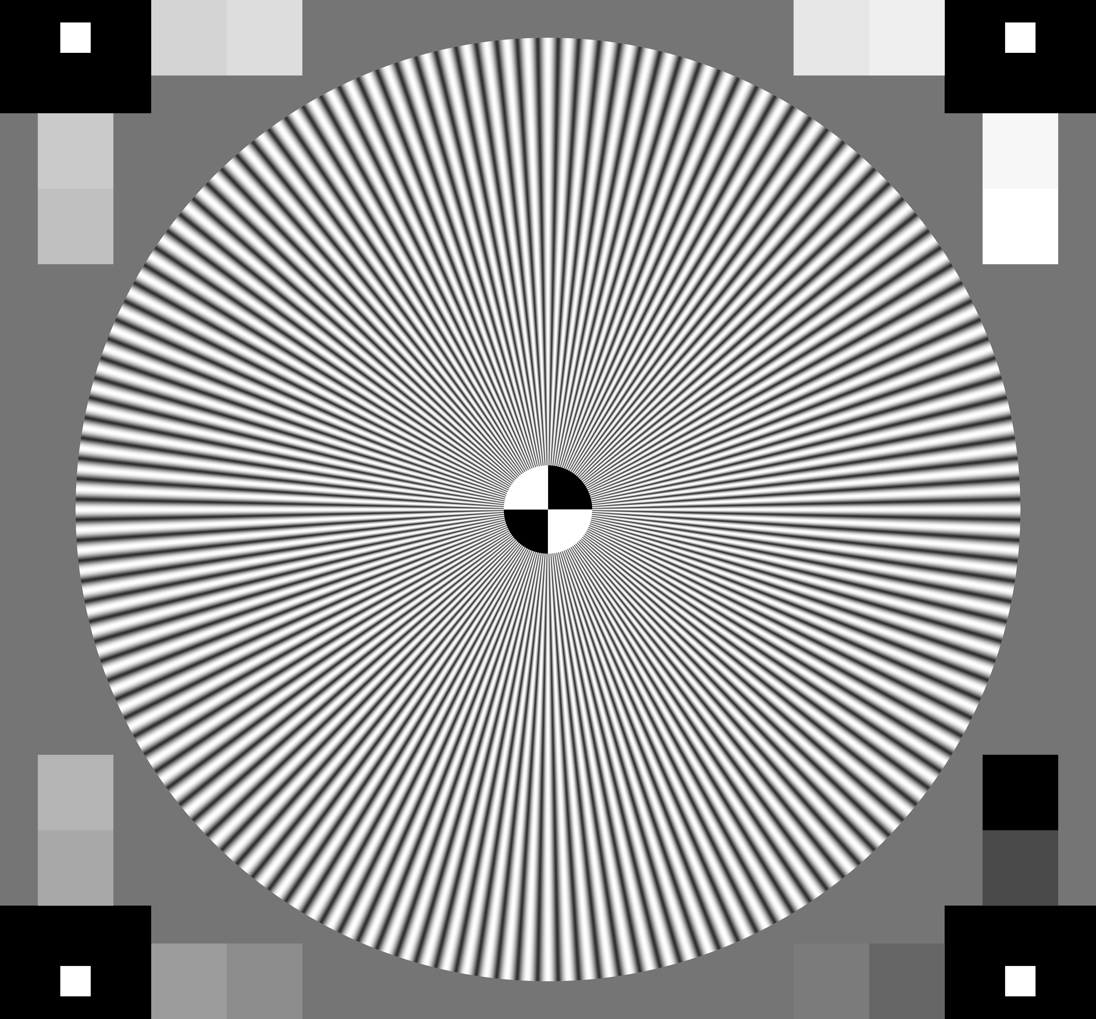
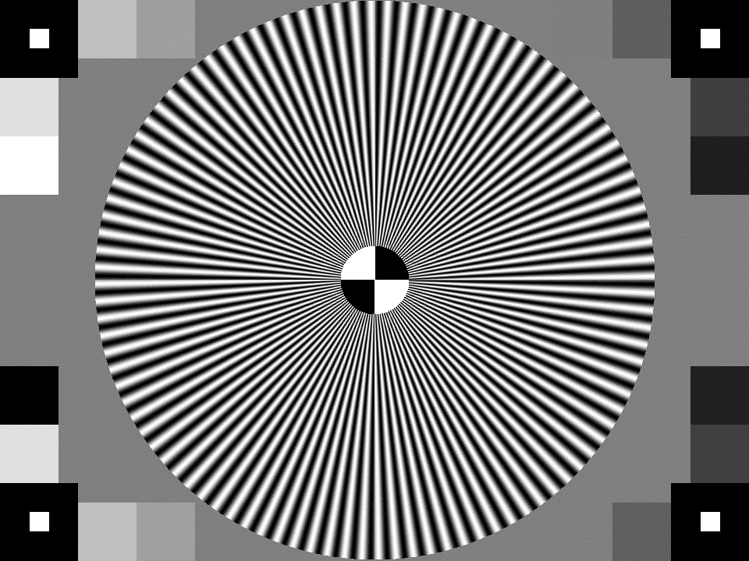
13.1 original TV Test image and our resulted image “grayImage13.bmp”
We can see that we have managed to create a TV image that is quite similar the original TV test image
We know that the code that created the resulted image is not as the lecturer asked for. After consulting with the lecturer – he asked us to write that notation down in the presentation and in the mail!
original TV Test image
our resulted image “grayImage13.bmp”

Slide 3
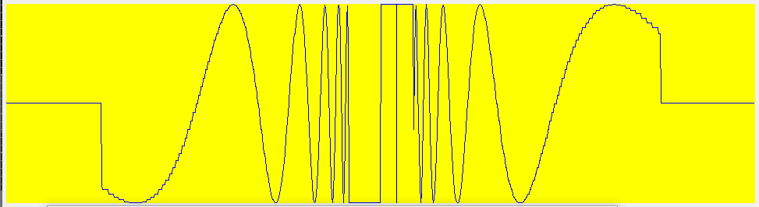
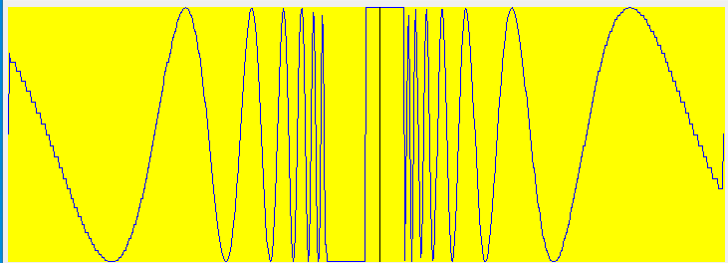
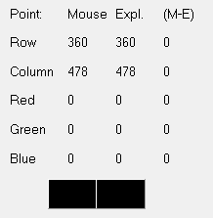
13.2 Relevant Profiles – part 1 (to prove that image “grayImage13.bmp” was created as required)
New-grayImage13.bmp
Row (left and right)
Column (up and down)
Notation: I tried to analyze also the original given BMP image but the BMP viewer did not work (showed very wired results) for it also when the lecturer tried to use. So we present only the profile of the created image
location
RGB values

Slide 4
13.2 Relevant Profiles – part 2 – conclusions (to prove that image “grayImage13.bmp” was created as required)
The row and column profiles reveal symmetrical patterns, indicating that the original image has symmetrical features. This is consistent with the radial pattern in the original image, where similar intensity variations occur at equidistant points from the center.
The sharp transitions and periodic oscillations in the profiles suggest a central point with radially distributed patterns. In the original image, this is the center of the concentric circles and lines, where the intensity changes rapidly as you move away from the center.
The distinct steps or plateaus in the profiles indicate the presence of rectangular blocks in the image. These blocks are visible in the corners and edges of the original image

Slide 5
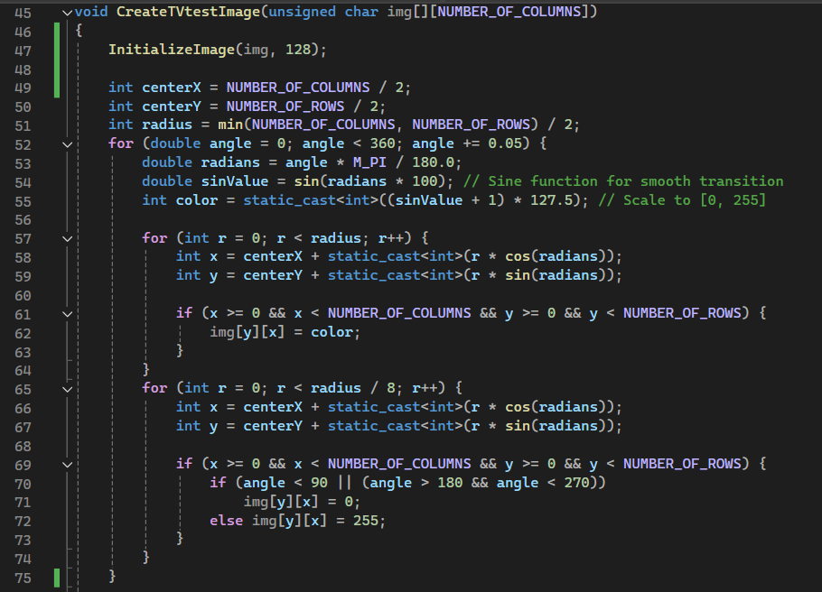
13.3 Code of the function “CreateTVtestImage” – part 1
In the CreateTVtestImage function – there are 3 major components to be created:
Initialization
Central Circular Pattern
Grayscale Blocks
Each will be explained deeper after the presentation of the code

Slide 6
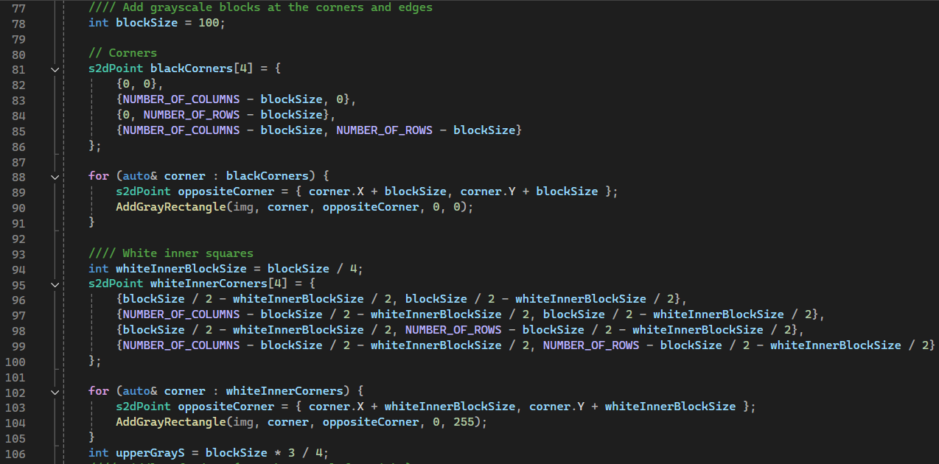
13.3 Code of the function “CreateTVtestImage” – part 2

Slide 7
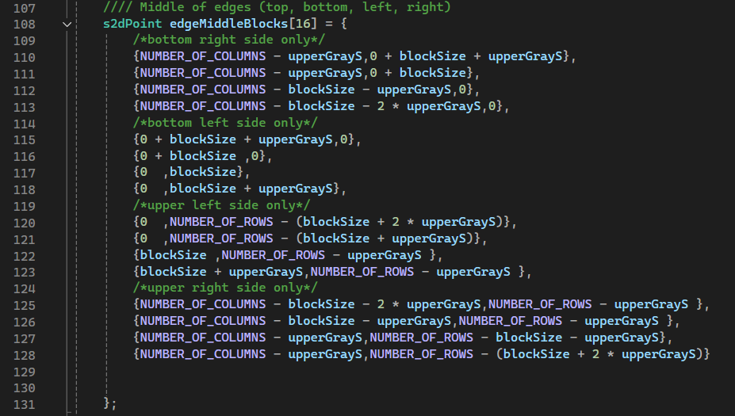
13.3 Code of the function “CreateTVtestImage” – part 3

Slide 8
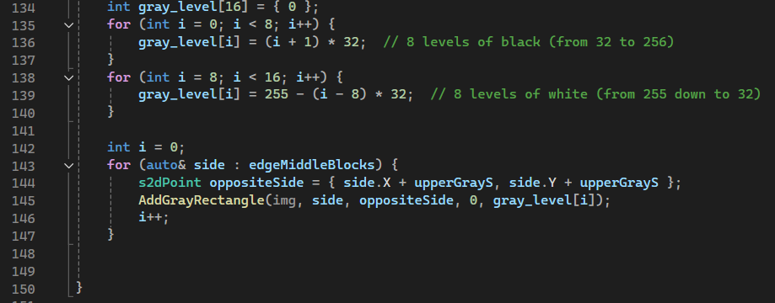
13.3 Code of the function “CreateTVtestImage” – part 4

Slide 9




13.3 Code of the function “CreateTVtestImage” – part 5
Initialization:
The function starts by calling InitializeImage(img, 128) to set all pixels to a medium gray value (128).
The CreateTVtestImage function initializes an image with a gray background.
Central Circular Pattern:
The center of the image is calculated, and a circular pattern is drawn using a sine function to create a smooth transition of colors.
A loop runs through angles from 0 to 360 degrees in small increments (0.05 degrees).
For each angle, the sine function is used to determine the color intensity.
Two nested loops draw circles: one for the full radius and one for a smaller radius (1/8th of the full radius) to create alternating black and white segments.

Slide 10
13.3 Code of the function “CreateTVtestImage” – part 6
Grayscale Blocks:
Four black rectangles are added at the corners of the image.
Will be marked as:
Four white inner squares are added near the corners.
Will be marked as:
16 gray rectangles are added at the edges of the image, with varying gray levels.
Will be marked as:

Slide 11
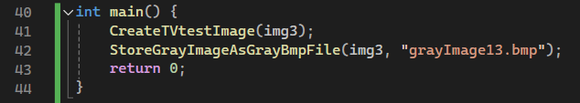
13.4 Code of the main function

Slide 12
13.5 What did we learned?
The code shows how to create complex patterns, such as a radial pattern with sinusoidal variations in pixel intensity, and how to draw rectangles with different gray levels. This involves understanding geometric transformations and basic trigonometry.
The code demonstrates how to represent and manipulate image data using a 2D array. Each element of the array corresponds to a pixel value in the grayscale image.
By working through this code, one can gain a deeper understanding of image processing techniques, geometric transformations, and file handling in C++.

